Slide 1

JavaScript & jQuery Development
© 2018/2019 Seavus Education & Development Center

Slide 2
What is jQuery
Javascript Library
Fast and concise
Simplifies the interaction between HTML and JavaScript

Slide 3
Why jQuery?
Lightweight : 19KB in size (Minified and Gzipped)
CSS1 - 3 Complaint
Cross Browser
(IE 6.0+, FF 2+, Safari 3.0+, Opera 9.0+, Chrome)

Slide 4
Why jQuery?
DOM Manipulation
before(), after(), append(), appendTo(), …..
Attributes
css(), addClass(), attr(), html(), val(), …..
Events
click(), bind(), unbind(), live(), …..
Effects
hide(), fadeOut(), toggle(), animate(), …..
Ajax
load(), get(), ajax(), getJSON(), …..

Slide 5
Why jQuery?
Lightweight : 19KB in size (Minified and Gzipped)
CSS1 - 3 Complaint
Cross Browser
(IE 6.0+, FF 2+, Safari 3.0+, Opera 9.0+, Chrome)
Great Community Plugins
Tutorials TestCoverage
Open (free) license Books

Slide 6














Who’s using jQuery?
http://docs.jquery.com/Sites_Using_jQuery

Slide 7
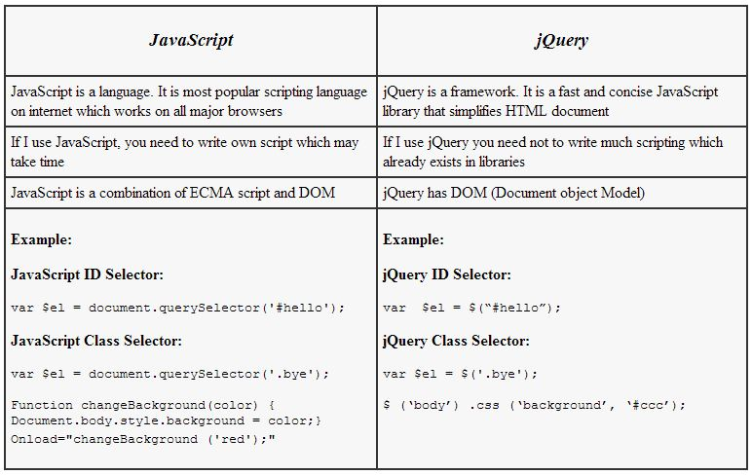
JavaScript VS jQuery

Slide 8
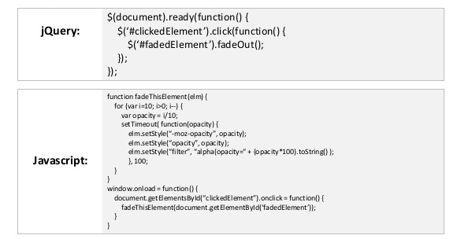
JavaScript VS jQuery

Slide 9
Let’s Start
Download jQuery
http://docs.jquery.com/Downloading_jQuery
Your best friend while working with jQuery
http://api.jquery.com/

Slide 10
Embed in you page
<html>
<head>
<script src=“path/to/jquery-x.x.js"></script>
</head>
<body> … </body>
</html>

Slide 11
Embed in you page
<html>
<head>
<script src="path/to/jquery-x.x.js"></script>
<script>
$(document).ready(function(){
// Start here
});
</script>
</head>
<body> … </body>
</html>

Slide 12
$(“div”).addClass(“xyz”);
jQuery philosophy
{
Find Some Elements
}
Do something with them
jQuery Object

Slide 13
A Basic Example
<body>
<div>
<p>I m a paragraph 1</p>
<p>I m a paragraph 2</p>
</div>
<p>I m another paragraph</p>
</body>

Slide 14
A Basic Example
Select all paragraphs.
$(“p”)
<body>
<div>
<p>I m a paragraph 1</p>
<p>I m a paragraph 2</p>
</div>
<p>I m another paragraph</p>
</body>

Slide 15
A Basic Example
Select all paragraphs. Add a class to them.
$(“p”).addClass(“red”);
<body>
<div>
<p class=“red”>I m a paragraph -1</p>
<p class=“red”>I m a paragraph -2</p>
</div>
<p class=“red”>I m another paragraph</p>
</body>

Slide 16
Selector Basics
Just pass a selector to $()
What is selector?
Use any CSS selector

Slide 17
Selector Basics
Think about your simplest css file.
#header{
margin : 0 auto;
}
div{
margin : 0px;
padding : 0px
}
ul.menu li{
…..
}

Slide 18
Selector Basics
The red colored items are selectors
#header{
margin : 0 auto;
}
div{
margin : 0px;
padding : 0px
}
ul.menu li{
…..
}

Slide 19
Selector Basics
Selecting using selectors
Selecting By Id
$(“#header”)

Slide 20
Selector Basics
Selecting using selectors
Selecting By Id
$(“#header”)
Selecting By Class
$(“.updated”)

Slide 21
Selector Basics
Selecting using selectors
Selecting By Id
$(“#header”)
Selecting By Class
$(“.updated”)
Selecting by tag name
$(“table”)

Slide 22
Selector Basics
Selecting using selectors
Selecting By Id
$(“#header”)
Selecting By Class
$(“.updated”)
Selecting by tag name
$(“table”)
Combine them
$(“table.user-list”)
$(“#footer ul.menu li”)

Slide 23
Basic Selector Example
This is my page
<body>
<div id=“header”>
<span id=“logo”>Logo here…</span>
<ul class=“menu”>
<li>user name</li>
…..
<li>logout</li>
</ul>
</div>
……
</body>

Slide 24
Basic Selector Example
$(“#header”)
<body>
<div id=“header”>
<span id=“logo”>Logo here…</span>
<ul class=“menu”>
<li>user name</li>
…..
<li>logout</li>
</ul>
</div>
……
</body>

Slide 25
Basic Selector Example
$(“ul.menu”)
<body>
<div id=“header”>
<span id=“logo”>Logo here…</span>
<ul class=“menu”>
<li>user name</li>
…..
<li>logout</li>
</ul>
</div>
……
</body>

Slide 26
Basic Selector Example
$(“ul.menu li”)
<body>
<div id=“header”>
<span id=“logo”>Logo here…</span>
<ul class=“menu”>
<li>user name</li>
…..
<li>logout</li>
</ul>
</div>
……
</body>

Slide 27
Dom Manipulation Example
Move all paragraphs in div with id “contents”
$(“p”)
<body>
<h1>jQuery</h1>
<p>jQuery is good</p>
<p>jQuery is better</p>
<div id=“contents”></div>
<p>jQuery is the best</p>
</body>

Slide 28
Dom Manipulation Example
Move all paragraphs in div with id “contents”
$(“p”).appendTo(“#contents”);
<body>
<h1>jQuery</h1>
<div id=“contents”>
<p>jQuery is good</p>
<p>jQuery is better</p>
<p>jQuery is the best</p>
</div>
</body>

Slide 29
Dom Manipulation Example
Move all paragraphs in div with id “contents”
$(“p”).appendTo(“#contents”);
$(“h1”).append(“ Dom Manipulation”);
<body>
<h1>jQuery Dom Manipulation</h1>
<div id=“contents”>
<p>jQuery is good</p>
<p>jQuery is better</p>
<p>jQuery is the best</p>
</div>
</body>

Slide 30
Attributes Example
Make the texts of last paragraph bold
$(“#contents p:last”).css(“color”, “green”);
<body>
<h1>jQuery Dom Manipulation</h1>
<div id=“contents”>
<p >jQuery is good</p>
<p>jQuery is better</p>
<p style=“color:green”>jQuery is the best</p>
</div>
</body>

Slide 31
Using filters for selecting
Basic Filters
:first, :last, :even, :odd, …...

Slide 32
Basic Filters Example
Student list table. Lets make it zebra.
Name | Class | Roll No. | Comment
Dejan | XII | 2 | Good
Ivan | IX | 1 | Good
Filip | XII | 3
Petar | XII | 5
Riste | VI | 2 | Satisfactory

Slide 33
Basic Filters Example
$(“#students tr:even”).css(“background-color”, “#dde”)
Name | Class | Roll No. | Comment
Dejan | XII | 2 | Good
Ivan | IX | 1 | Good
Filip | XII | 3
Petar | XII | 5
Riste | VI | 2 | Satisfactory

Slide 34
Using filters for selecting
Basic Filters
:first, :last, :even, :odd, …...
Content Filters:
:empty , :contains(text), :has(selector), …..

Slide 35
Task 1
Create a div with class “dynamic-div” element with some text and append it to the end of the document body.
Create a paragraph element with some text and append it to the end of the previously created div.
Time to accomplish:
10 min

Slide 36
Task 2
Add 3 more paragraphs in the div you’ve created in the prevous example, you should have total of 4 paragraphs.
Color the odd paragrahs in the div green, and the even paragraphs yellow.
Time to accomplish
15 min

Slide 37
Using filters for selecting
Basic Filters
:first, :last, :even, :odd, …...
Content Filters:
:empty , :contains(text), :has(selector), …..
Attribute Filters:
[attribute], [attribute=value], [attribute!=value], …..

Slide 38
Using filters for selecting
Basic Filters
:first, :last, :even, :odd, …...
Content Filters:
:empty , :contains(text), :has(selector), …..
Attribute Filters:
[attribute], [attribute=value], [attribute!=value], …..
Forms
:input, :text, :submit, :password, …..
:enabled, :disabled, :checked, …..

Slide 39
Now we can Select
Let’s perform some action

Slide 40
More Attributes Example
Setting
$(“img.logo”).attr(“align”, “left”);
$(“p.copyright”).html(“&copy; 2009 ajaxray”);
$(“input#name”).val(“Spiderman”);

Slide 41
More Attributes Example
Setting
$(“img.logo”).attr(“align”, “left”);
$(“p.copyright”).html(“&copy; 2009 ajaxray”);
$(“input#name”).val(“Spiderman”);
Getting
var allignment = $(“img.logo”).attr(“align”);
var copyright = $(“p.copyright”).html();
var username = $(“input#name”).val();

Slide 42
Event Example
Start when DOM is ready
$(document).ready(function(){
$(selector).eventName(function(){…});
});

Slide 43
Event Example
Bind all interactions on events.
$(document).ready(function(){
$(“#message”).click(function(){
$(this).hide();
})
});
<span id=“message” onclick=“…”> blah blah </span>

Slide 44
Event Example
You can fire events manually.
$(document).ready(function(){
$(“span#message”).click(function(){
$(this).hide();
})
$(“#form-id:reset”).click();
});

Slide 45
jQuery Methods
DOM Manipulation
before(), after(), append(), appendTo(), …..
Attributes
css(), addClass(), attr(), html(), val(), …..
Events
click(), bind(), unbind(), live(), …..
Effects
hide(), fadeOut(), toggle(), animate(), …..

Slide 46
Effects Example
When “show-cart” link clicked, slide up/down “cart” div.
$(“a#show-cart”).click(function(){
$(“#cart”).slideToggle(“slow”);
})

Slide 47
Effects Example
Build your custom animation
$(“a#show-cart”).click(function(){
$(“#cart”).slideToggle(“slow”);
})
$("#showdown").click(function(){
$("#my-div").animate({
width: "70%",
opacity: 0.4,
fontSize: "3em“
}, 1200 );
});

Slide 48
Task 4
On changing value in some input element display paragraph below the input with text: “Text has been changed”.
Time to accomplish:
10 min

Slide 49
Questions?

Slide 50
THANK YOU

